Slide 1
OpenDSS APIs
Roger Dugan Sr. Technical Executive
UCF OpenDSS Workshop July 26-27, 2018 Orlando, FL

Slide 2
Application Programming Interfaces (API)

Slide 3
Why You Might Want to Write Some Code …
There is no looping in the DSS scripting language
To implement an algorithm not in OpenDSS
For optimizing device siting …
Generators
Capacitors
Reclosers
To automate some repetitive analysis task
To develop a new device model or control
Using the COM interface
Writing a Dynamic-Linked Library (DLL)

Slide 4
Ways to Write Code to Do Innovative Things with OpenDSS
COM Interface
Microsoft standard: Windows only
Well-supported in MS Office, Python, Matlab, etc.
DirectDLL Interface
Standard function call library
Use a separate program to generate DSS scripting code
Run with standalone EXE
Create a file with DSS commands
Redirect to it

Slide 5
DSS Structure
Scripts
Main Simulation Engine
COM Interface
User-Written DLLs
Scripts, Results

Slide 6
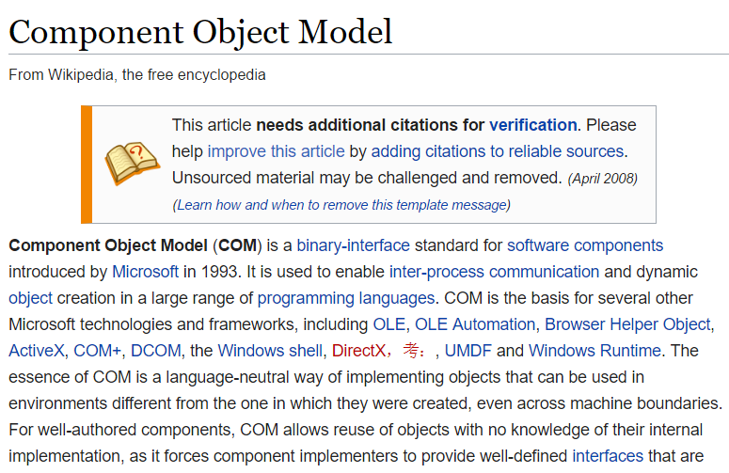
COM Interface

Slide 7
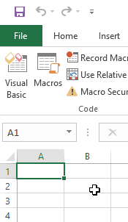
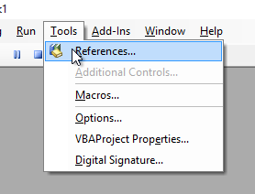
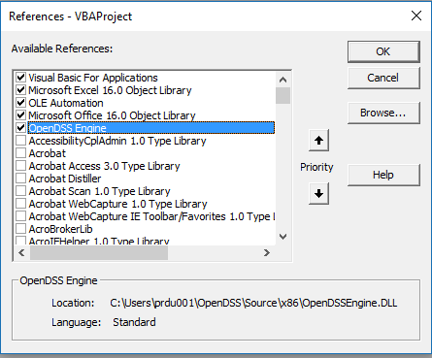
Finding COM Servers on Your Computer
Excel VBA

Slide 8
OpenDSS COM Interfaces
There are many interfaces supplied by the COM server
There is one registered In-Process COM interface:
OpenDSSEngine.DSS
The DSS interface is the one your program instantiates
The DSS interface then creates all the others.
This is for simplicity for users who are not necessarily familiar with COM programming

Slide 9
“Active objects” concept
.The interfaces generally act on the ACTIVE object
Active circuit,
Active circuit element,
Active bus, etc.
The interfaces generally point to the active object
To work with another object, change the active object
There are methods for selecting objects
You may also use script commands

Slide 10
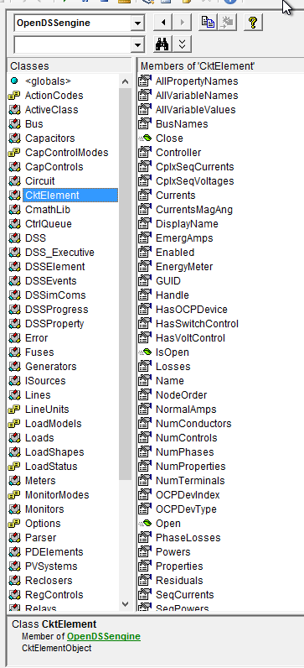
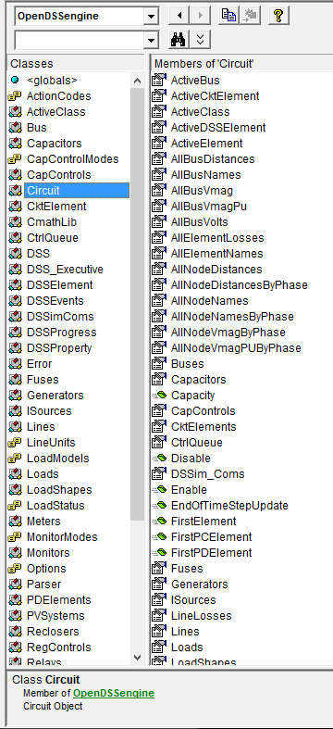
Object Browser in VBA for OpenDSSEngine
The Object Browser in MS Office VBA is a good way to learn what is available through the OpenDSS COM Interface

Slide 11
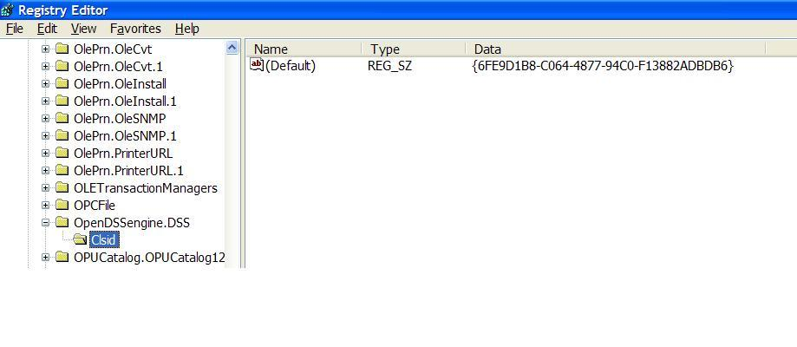
The in-process COM server in the Windows Registry
Windows Registry Entry
GUID
The Server shows up as “OpenDSSEngine.DSS” in the Windows Registry
The OpenDSS is now available to any program on the computer

Slide 12
What Languages Can You use for Code?
Excel VBA
VB.net
C#
C/C++
Delphi, Free Pascal
MATLAB
Python
Java
LabView
R
Fortran (for DLLs, with DirectDLL)
Julia (with DirectDLL)

Slide 13
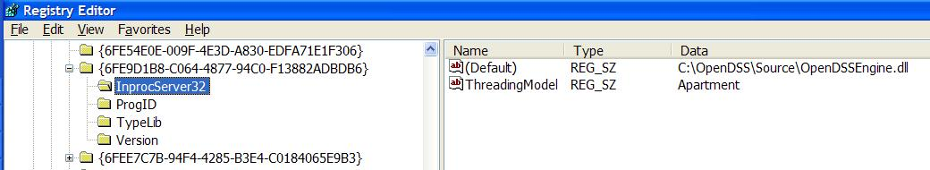
The GUID References the DLL File ….
If you look up the GUID in RegEdit
Points to OpenDSSEngine.DLL (In-process server, Apartment Threading model)

Slide 14
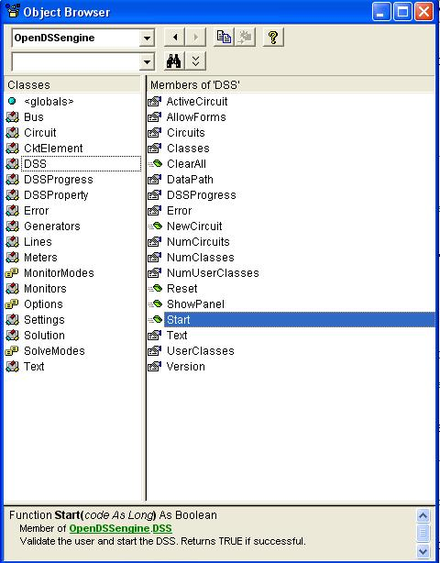
DSS Interface
This is the main interface. It is instantiated upon loading OpenDSSEngine.DSS and then instantiates all other interfaces internally
Call the Start(0) method to initialize the DSS
DSS Class Functions (methods) and Properties

Slide 15
Linking Your Program to the COM Server
Examples of accessing the COM server in various languages
In MATLAB:
DSSobj = actxserver(‘OpenDSSEngine.DSS’);
In Excel VBA: (Early binding)
Public DSSobj As OpenDSSEngine.DSS Set DSSobj = New OpenDSSEngine.DSS
In Delphi
{Import Type Library}
DSSObj := coDSS.Create;
In PYTHON:
self.engine = win32com.client.Dispatch("OpenDSSEngine.DSS")

Slide 16
A Simple Excel VBA Macro
To run the IEEE 123-bus Test Feeder and plot the voltage profile

Slide 17
Option Explicit
Public MyOpenDSS As OpenDSSengine.DSS
Public MyText As OpenDSSengine.Text
Public MyCircuit As OpenDSSengine.Circuit
Public Sub MyMacro()
Set MyOpenDSS = New OpenDSSengine.DSS
MyOpenDSS.Start (0)
Set MyText = MyOpenDSS.Text
Set MyCircuit = MyOpenDSS.ActiveCircuit
MyText.Command = "Compile (C:\OpenDSS\IEEETestCases\123Bus\IEEE123Master.dss)"
MyText.Command = "New Energymeter.M1 element=Line.L115 terminal=1"
MyText.Command = "Solve"
Dim MyVoltages As Variant
Dim MyNames As Variant
Dim Mydistances As Variant
MyVoltages = MyCircuit.AllBusVmagPu
MyNames = MyCircuit.AllNodeNames
Mydistances = MyCircuit.AllNodeDistances
Dim i As Integer, irow As Integer
irow = 1
For i = LBound(MyVoltages) To UBound(MyVoltages)
ActiveSheet.Cells(irow, 1).Value = MyNames(i)
ActiveSheet.Cells(irow, 2).Value = Mydistances(i)
ActiveSheet.Cells(irow, 3).Value = MyVoltages(i)
irow = irow + 1
Next I
Set MyOpenDSS = Nothing
End Sub

Slide 18
Steps Required to Do This
Register OpenDSSEngine.DLL (32-bit)
Start Microsoft Excel
Type alt-F11 to open VBA editor
Or Tools>Macro …
Select OpenDSS Engine under Tools>References
Insert>Module
Enter the VBA code into blank module
Use correct path name for your computer
Execute the macro “MyMacro”

Slide 19
Resulting Chart in Excel

Slide 20
VBA Example
Option Explicit
Public DSSobj As OpenDSSengine.DSS
Public DSSText As OpenDSSengine.Text
Public DSSCircuit As OpenDSSengine.Circuit
Public Sub StartDSS()
' Create a new instance of the DSS
Set DSSobj = New OpenDSSengine.DSS
' Assign a variable to the Text interface for easier access
Set DSSText = DSSobj.Text
' Start the DSS
If Not DSSobj.Start(0) Then MsgBox "DSS Failed to Start"
End Sub
Define some public variables that are used throughout the project
This routine instantiates the DSS and starts it. It is also a good idea at this time to assign the text interface variable.

Slide 21
VBA Example
Public Sub LoadCircuit(fname As String)
' Always a good idea to clear the DSS when loading a new circuit
DSSText.Command = "clear"
' Compile the script in the file listed under "fname" cell on the main form
DSSText.Command = "compile " + fname
' The Compile command sets the current directory the that of the file
' Thats where all the result files will end up.
' Assign a variable to the Circuit interface for easier access
Set DSSCircuit = DSSobj.ActiveCircuit
End Sub
This subroutine loads the circuit from the base script files using the Compile command through the Text interface. “fname” is a string contains the name of the master file.
There is an active circuit now, so assign the DSSCircuit variable.

Slide 22
VBA Example
Public Sub LoadSeqVoltages()
' This Sub loads the sequence voltages onto Sheet1 starting in Row 2
Dim DSSBus As OpenDSSengine.Bus
Dim iRow As Long, iCol As Long, i As Long, j As Long
Dim V As Variant
Dim WorkingSheet As Worksheet
Set WorkingSheet = Sheet1 'set to Sheet1 (target sheet)
iRow = 2
For i = 1 To DSSCircuit.NumBuses ' Cycle through all buses
Set DSSBus = DSSCircuit.Buses(i) ' Set ith bus active
' Bus name goes into Column 1
WorkingSheet.Cells(iRow, 1).Value = DSSCircuit.ActiveBus.Name
' Load sequence voltage magnitudes of active bus into variant array
V = DSSBus.SeqVoltages
' Put the variant array values into Cells
' Use Lbound and UBound because you don't know the actual range
iCol = 2
For j = LBound(V) To UBound(V)
WorkingSheet.Cells(iRow, iCol).Value = V(j)
iCol = iCol + 1
Next j
iRow = iRow + 1
Next i
End Sub
This Sub puts the sequence voltage onto a spreadsheet
Define a variable for the Bus interface
Define a variant to pick up the arrays
Cycle through all the buses
Get the bus name
Get the voltages into the variant array
Put them on the spreadsheet

Slide 23
MATLAB Examples

Slide 24
MATLAB Startup Function
%--------------------------------------------------------------------------
function [Start,DSSObj,Text] = DSSStartup
% Function for starting up the DSS
%instantiate the DSS Object
DSSObj = actxserver('OpenDSSEngine.DSS');
%
%Start OpenDSS. Only needs to be executed the first time w/in a
%Matlab session
Start = DSSObj.Start(0);
% Define a variable that points to the text interface
Text = DSSObj.Text;

Slide 25
MATLAB Startup Function
% Examples of using Matlab to plot the voltage profile and other data
% NOTE: if this doesn't work, you might try updating your openDSS version
% Also, don't forget to register OpenDSSEngine.DLL (see instructions)
% execute DSSStartup.m
[DSSStartOK, DSSObj, DSSText] = DSSStartup;
if DSSStartOK
DSSText.command='Compile (C:\opendss\IEEETestCases\123Bus\IEEE123Master.dss)';
% Set up the interface variables
DSSCircuit=DSSObj.ActiveCircuit;
DSSSolution=DSSCircuit.Solution;
% Add an EnergyMeter object so the distances down the feeder are
% computed
DSSText.Command='New EnergyMeter.Main Line.SW1 1';
% Add a Monitor, too
DSSText.Command='New Monitor.FeederEnd Line.L99 1';
% Limit regulator tap changes to 1 tap per change to better
% approximate the published results
% This example does this using the RegControls collection in the COM
% interface instead of the Command interface
% Assign a Variable to the RegControls interface
Regulators = DSSCircuit.RegControls;
% cycle through all the regulators using First .. Next
iReg = Regulators.First;
while iReg>0
Regulators.MaxTapChange = 1;
Regulators.Delay = 30; % set all delays to 30s
iReg = Regulators.Next;
end
% now set creg1a delay to 15s so it goes first
<SNIP>

Slide 26
Example Solution Loop in MATLAB
% Solve executes the solution for the present solution mode, which is "snapshot" and
% establishes the bus list.
% We're going to do the solution in pieces to demonstrate how it is
% done
MyControlIterations = 0;
while MyControlIterations < DSSSolution.MaxControlIterations
DSSSolution.SolveNoControl;
% display the result
disp(['Result=' DSSText.Result])
if DSSSolution.Converged
a = ['Solution Converged in ' num2str(DSSSolution.Iterations) ' iterations.'];
else
a = 'Solution did not Converge';
end
disp(a)
DSSSolution.SampleControlDevices;
DSSSolution.DoControlActions;
if DSSSolution.ControlActionsDone, break, end
MyControlIterations = MyControlIterations + 1;
end

Slide 27
Another Example in MATLAB
% ---------------------------------------------------------------------
% Run a Daily analysis and plot the voltages at the end of the feeder
% --------------------------------------------------------------------
% First set all the Load daily properties to Default
DSSLoads = DSSCircuit.Loads;
iLoad = DSSLoads.First;
while iLoad>0
DSSLoads.daily = 'default';
iLoad = DSSLoads.Next;
end
DSSText.Command = 'set mode=daily';
DSSSolution.Solve;
% Export monitor
DSSText.Command = 'export mon FeederEnd';
MonFileName = DSSText.Result;
MyCSV = csvread(MonFileName, 1, 0);
Hour = MyCSV(:,1);
Volts1 = MyCSV(:,3);
Volts2 = MyCSV(:,5);
Volts3 = MyCSV(:,7);
figure(2);
plot(Hour, Volts1,'-k+'); % black *
hold on
plot(Hour, Volts2,'-r+');
plot(Hour, Volts3,'-b+');
title('Daily Simulation');
ylabel('Volts');
xlabel('Hour');
hold off
See “MiscExamples.m” in …\Examples\Matlab

Slide 28
Direct DLL
(See OpenDSS_Direct_DLL.PDF in the Doc folder)

Slide 29
Why Use DirectDLL?
Your programming language does not support COM
In a non-Windows environment such as Apache server
Your programming language does not support early bindings in COM and you want to speed things up
MATLAB
See “COM Speed Comparison.pdf” in the Doc folder
If your programming language supports early binding in COM, continue to use the COM interface
The properties implemented in this library are the same implemented in the COM interface; Just accessed differently

Slide 30
DirectDLL Functions
BUSI 0x00a4a9f0 0x0064a9f0 124 (0x7c) OpenDSSDirect.dll C:\Users\prdu001\OpenDSS\Source\x64\OpenDSSDirect.dll Exported Function
BUSS 0x00a4b220 0x0064b220 122 (0x7a) OpenDSSDirect.dll C:\Users\prdu001\OpenDSS\Source\x64\OpenDSSDirect.dll Exported Function
BUSV 0x00a4b340 0x0064b340 121 (0x79) OpenDSSDirect.dll C:\Users\prdu001\OpenDSS\Source\x64\OpenDSSDirect.dll Exported Function
CapacitorsF 0x00a5c160 0x0065c160 86 (0x56) OpenDSSDirect.dll C:\Users\prdu001\OpenDSS\Source\x64\OpenDSSDirect.dll Exported Function
CapacitorsI 0x00a5bd40 0x0065bd40 87 (0x57) OpenDSSDirect.dll C:\Users\prdu001\OpenDSS\Source\x64\OpenDSSDirect.dll Exported Function
CapacitorsS 0x00a5c330 0x0065c330 85 (0x55) OpenDSSDirect.dll C:\Users\prdu001\OpenDSS\Source\x64\OpenDSSDirect.dll Exported Function
CapacitorsV 0x00a5c5e0 0x0065c5e0 84 (0x54) OpenDSSDirect.dll C:\Users\prdu001\OpenDSS\Source\x64\OpenDSSDirect.dll Exported Function
CapControlsF 0x00a5f270 0x0065f270 74 (0x4a) OpenDSSDirect.dll C:\Users\prdu001\OpenDSS\Source\x64\OpenDSSDirect.dll Exported Function
CapControlsI 0x00a5ee40 0x0065ee40 75 (0x4b) OpenDSSDirect.dll C:\Users\prdu001\OpenDSS\Source\x64\OpenDSSDirect.dll Exported Function
CapControlsS 0x00a5f920 0x0065f920 73 (0x49) OpenDSSDirect.dll C:\Users\prdu001\OpenDSS\Source\x64\OpenDSSDirect.dll Exported Function
CapControlsV 0x00a5fdc0 0x0065fdc0 72 (0x48) OpenDSSDirect.dll C:\Users\prdu001\OpenDSS\Source\x64\OpenDSSDirect.dll Exported Function
CircuitF 0x00a47390 0x00647390 127 (0x7f) OpenDSSDirect.dll C:\Users\prdu001\OpenDSS\Source\x64\OpenDSSDirect.dll Exported Function
CircuitI 0x00a46e30 0x00646e30 128 (0x80) OpenDSSDirect.dll C:\Users\prdu001\OpenDSS\Source\x64\OpenDSSDirect.dll Exported Function
CircuitS 0x00a47440 0x00647440 126 (0x7e) OpenDSSDirect.dll C:\Users\prdu001\OpenDSS\Source\x64\OpenDSSDirect.dll Exported Function
CircuitV 0x00a47ab0 0x00647ab0 125 (0x7d) OpenDSSDirect.dll C:\Users\prdu001\OpenDSS\Source\x64\OpenDSSDirect.dll Exported Function
CktElementF 0x00a428a0 0x006428a0 133 (0x85) OpenDSSDirect.dll C:\Users\prdu001\OpenDSS\Source\x64\OpenDSSDirect.dll Exported Function
CktElementI 0x00a42320 0x00642320 134 (0x86) OpenDSSDirect.dll C:\Users\prdu001\OpenDSS\Source\x64\OpenDSSDirect.dll Exported Function
CktElementS 0x00a42b20 0x00642b20 132 (0x84) OpenDSSDirect.dll C:\Users\prdu001\OpenDSS\Source\x64\OpenDSSDirect.dll Exported Function
CktElementV 0x00a430e0 0x006430e0 131 (0x83) OpenDSSDirect.dll C:\Users\prdu001\OpenDSS\Source\x64\OpenDSSDirect.dll Exported Function
….

Slide 31
Dynamics Solution

Slide 32
Dynamics Mode
Dynamics mode is used for
Fault current calculations including Generator contributions
Single time-step solution
Machine transients
Inverter transients
Typical time step: 0.2 – 1 ms
Depends on time constants in model
A converged power flow is required to initialize the model.

Slide 33
Basic Algorithm (From SolutionAlgs.Pas)
Increment_time;
{Predictor}
IterationFlag := 0;
IntegratePCStates;
SolveSnap;
{Corrector}
IterationFlag := 1;
IntegratePCStates;
SolveSnap;

Slide 34
Entering Dynamics Mode
Initialize state variables in all PC Elements
For example, in a Generator object currently:
Compute voltage, E₁, behind Xd‘ and Initialize the phase angle, θ, to match power flow (approximately)
Set derivatives of the state variables to zero
For the Generator: Speed (relative to synch frequency), Angle
Set controlmode=time
When running in time steps of a few seconds or less, controls that depend on the control queue for instructions on delayed actions will be automatically sequenced when the solution time reaches the designated time for an action to occur.

Slide 35
3-Phase Generator Model in Dynamics Mode
E∠θ

Slide 36
Differential Equations for Default Generator (1-Mass)
Derivative Calculation:
Integration
Trapezoidal integration formula for θ, for example:

Slide 37
User-Written DLLs
More complex behaviors can be modeled using Dynamic-Linked Libraries
Requires more sophisticated programming skills
Certain PCElements provide interfaces
Generator, Storage
Some Control elements, too (CapControl)
IndMach012a.DLL is an example supplied with the program
A symmetrical component based induction machine model for the Generator class element
(2017: now built in as a base model)

